Slide 1


Slide 2


AI-Powered Campus Navigation & Smart Help Desk System
Final Year Project Synopsis
Submitted by
ROLL | NAME
2301201119 | Siddhant k. Singh
2301201134 | Varun Sain
Faculty Mentor: Mr. Himanshu Kaushik
Notes:
New Courses replaced with New Programmes

Slide 3

Project Overview
Large campuses such as universities, hospitals, corporate parks, and government institutions often consist of multiple buildings, departments, and facilities spread across wide areas.
Navigating these environments becomes challenging for students, staff, visitors, and especially first-time users. Relying on physical signboards or manual help desks frequently leads to confusion, delays, and repeated dependency on staff assistance.
Key Challenges Addressed:
Difficulty in navigating large and complex campus layouts
Over-dependence on physical help desks and manual guidance
Lack of real-time, centralized campus information
Limited accessibility support for first-time and differently-abled users
Notes:
New Courses replaced with New Programmes

Slide 4
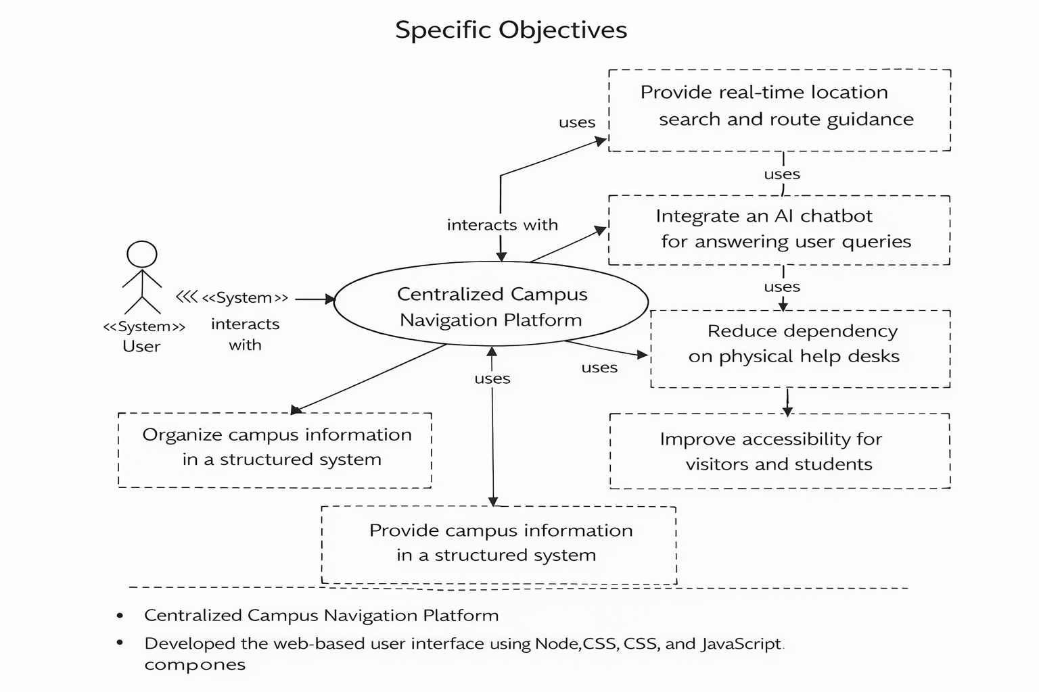
Specific Objectives
The main objectives of this project are:
To develop a centralized, web-based campus navigation and assistance system
To provide real-time location search and navigation within campus premises
To integrate an AI-powered chatbot for instant query resolution
To reduce dependency on physical help desks and manual guidance
To improve accessibility and ease of navigation for all users, including first-time visitors
Notes:
New Courses replaced with New Programmes

Slide 5
Key Features
The proposed solution is an AI-Powered Campus Navigation & Smart Help Desk System developed as a web-based platform using modern full-stack technologies.
Key Features Include:
AI-powered chatbot for instant, conversational assistance
Interactive digital campus map with real-time route guidance
Centralized campus information management
Web-based, responsive, and user-friendly interface
24/7 availability without dependency on physical help desks
Scalable architecture adaptable to different campus types
Reduced human intervention and improved operational efficiency
Notes:
New Courses replaced with New Programmes

Slide 6
Progress Summary
The following major modules and features have been developed.
1. Multi-Role Authentication System
Implemented a three-role login system for different users:
Students
Faculty
Admin
Each role has separate access permissions and functionalities within the system.
2. User Dashboard Interface
Developed a centralized dashboard for logged-in users.
The dashboard provides quick access to:
Navigation features
Class schedules
Timetable information
Help desk services.
3. Classroom Booking System
Implemented a booking structure for classrooms that allows scheduling of lecture halls or rooms.
Admin or faculty can manage booking information to avoid conflicts.
The system uses interactive maps and location search to guide users to their destination.
Notes:
New Courses replaced with New Programmes

Slide 7
Progress Summary
5. Course Timetable Module
Implemented a timetable system that displays course schedules for students and faculty.
Users can easily view their daily or weekly class timetable.
6. Class Scheduling Module
Developed a class scheduling structure that manages lecture timings and room allocations.
7. Digital Help Desk System
Implemented a virtual help desk interface to assist users with campus-related queries.
Provides information about departments, rooms, facilities, and campus services.
8. AI Chatbot Integration
Integrated an AI-powered chatbot module to handle user queries.
The chatbot provides assistance for:
Campus navigation
Location queries
General campus information.
Notes:
New Courses replaced with New Programmes

Slide 8
Detailed Progress – Development Phase
System Architecture:
Designed a layered architecture consisting of UI layer, backend services, database layer, AI chatbot module, and mapping services.
Implemented REST API communication between frontend and backend components.
Structured the system to support scalability and modular integration of AI and mapping services.
Frontend Development:
Developed the web-based user interface using React.js, HTML, CSS, and JavaScript.
Implemented the interactive campus map interface for displaying campus locations.
Created search functionality to locate buildings, departments, and facilities.
Integrated a chatbot interface for user interaction and query submission.
Designed the UI to be responsive and user-friendly across devices.
Notes:
New Courses replaced with New Programmes

Slide 9
Detailed Progress – Development Phase
Backend Development Developed the server-side architecture using Node.js and Express.js.
Created REST API endpoints for handling navigation queries and system requests.
Implemented business logic for route generation and data processing.
Integrated backend services with the AI chatbot module for query interpretation.
Managed communication between frontend interface, database, and mapping services.
Database Implementation
Designed a MongoDB database schema to store campus information.
Created collections for buildings, departments, facilities, and key locations.
Implemented database queries for retrieving campus data efficiently.
Notes:
New Courses replaced with New Programmes

Slide 10
Detailed Progress – Development Phase
AI Chatbot Integration
Implemented NLP-based chatbot processing for interpreting user queries.
Integrated chatbot with backend APIs to retrieve relevant campus data.
Enabled responses for location queries and navigation instructions.
Mapping & Navigation Integration
Integrated OpenStreetMap / Mapbox APIs for map visualization.
Implemented functionality to display campus locations and generate routes.
Connected mapping services with backend APIs and database.
Current Development Status
Chatbot and mapping integration in progress.
System moving toward final integration and testing phase.
Notes:
New Courses replaced with New Programmes

Slide 11
Methodology
The AI-Powered Campus Navigation & Smart Help Desk System is developed using a structured, modular approach to ensure scalability, efficiency, and ease of use. The overall workflow of the system is as follows:
For a better understanding of the workflow of this system, let us focus on the below points:
User accesses the web-based campus navigation system
Query is submitted through search or AI chatbot interface
Backend processes the request via REST APIs
AI chatbot analyzes intent using NLP
Campus data and routes are retrieved from database and map services
Navigation or information is displayed to the user
System is tested and refined through iterative improvements
Notes:
New Courses replaced with New Programmes

Slide 12
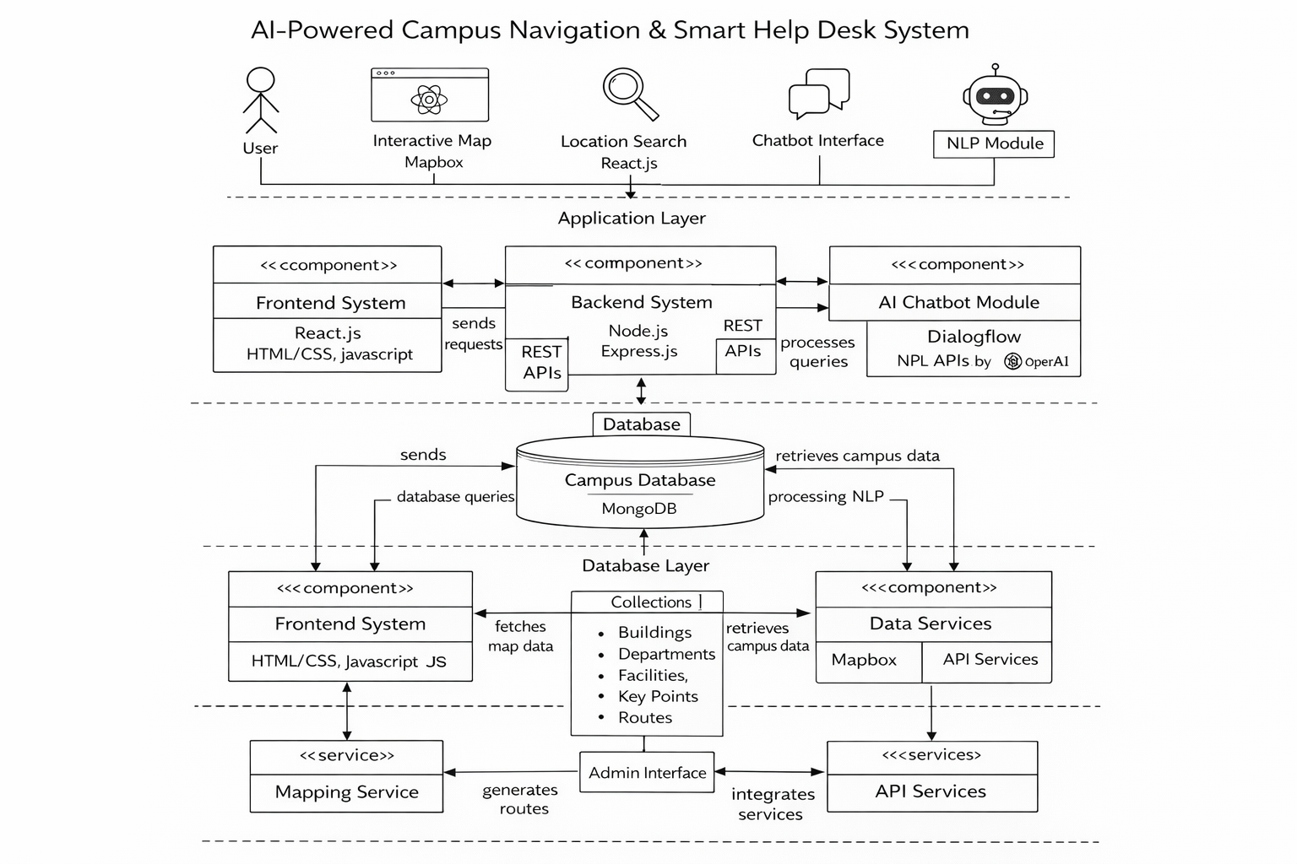

Prototype/Project Flow diagram/Architecture
Notes:
New Courses replaced with New Programmes

Slide 13
Project Timeline
Phase 1 (Weeks 1): Requirement Analysis & Planning
Analysis of campus layout, user requirements, navigation challenges, and system feasibility.
Phase 2 (Weeks 2-3): System Design & UI Development
Design of system architecture, database schema, and development of user-friendly frontend interface.
Phase 3 (Weeks 4-5): Backend Development & Data Integration
Implementation of backend services, REST APIs, and centralized campus data management.
Phase 4 (Weeks 6): AI Chatbot & Mapping Integration
Integration of NLP-based chatbot and interactive mapping services for navigation.
Phase 5 (Weeks 7-9): Testing, Optimization & Deployment
Functional testing, performance optimization, bug fixing, and final deployment.
Notes:
New Courses replaced with New Programmes

Slide 14
Next Steps and Goals
1. Advanced Navigation Optimization
Improve the campus navigation system with more precise routing between buildings, classrooms, and facilities. Implement optimized path generation for faster and more accurate directions.
2. Indoor Navigation Support
Extend the navigation system to support indoor navigation within buildings.
Enable users to locate specific classrooms, labs, and offices inside buildings.
3. Real-Time Data Updates
Implement real-time updates for class schedules, room availability, and bookings.
Ensure the system reflects dynamic changes in classroom allocation and schedules.
4. Enhanced AI Chatbot Capabilities
Improve the AI chatbot's natural language understanding to handle more complex queries.
Enable the chatbot to provide context-based responses related to schedules, navigation, and campus services.
Notes:
New Courses replaced with New Programmes

Slide 15
Data & Resources
The system is developed using modern web technologies to ensure responsiveness, scalability, and efficient data handling. These tools enable seamless integration between the user interface, backend services, and AI components.
The structure for the Tech-Stack focuses on the following:
Frontend: React.js, HTML5, CSS3, JavaScript
Backend: Node.js, Express.js
Database: MongoDB
AI & NLP: Chatbot frameworks, NLP APIs
Mapping: OpenStreetMap, Leaflet / Mapbox
APIs & Tools: REST APIs, Axios
Notes:
New Courses replaced with New Programmes

Slide 16
Expected Results & Impact
Following are the expected outcomes for Future Objectives:
Easy navigation to classrooms, departments, and campus facilities through the digital navigation system
Centralized access to timetables, schedules, and room information through a user dashboard
Efficient classroom booking and scheduling management to prevent conflicts
AI chatbot assistance for answering campus-related queries and navigation help
Improved user experience and accessibility for students, faculty, and visitors
Reduced administrative workload through automated help desk and information services
Scalable smart campus solution that can support future system enhancements and integrations.
Notes:
New Courses replaced with New Programmes

Slide 17
THANK YOU

